Slide 1
ME623 Dynamics of Machining Processes
Group No:5
NAVNEET KUMAR 236103103
AMIT KHARE 236103101
HARSHA VARDHAN.P 234103419

Slide 2
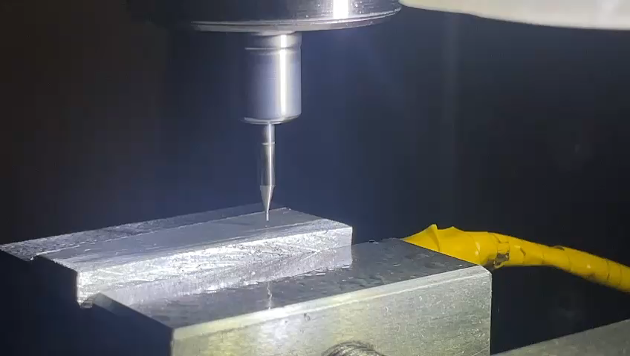
“Hands on project on micro milling process ”
To analyze and understand the dynamic behavior of the micro milling process.
This includes investigating the vibrations and accelerations experienced by the milling tool during operation, identifying any patterns or anomalies in the data, and potentially correlating these findings with the quality of the machined surface or other process parameters.

Slide 3
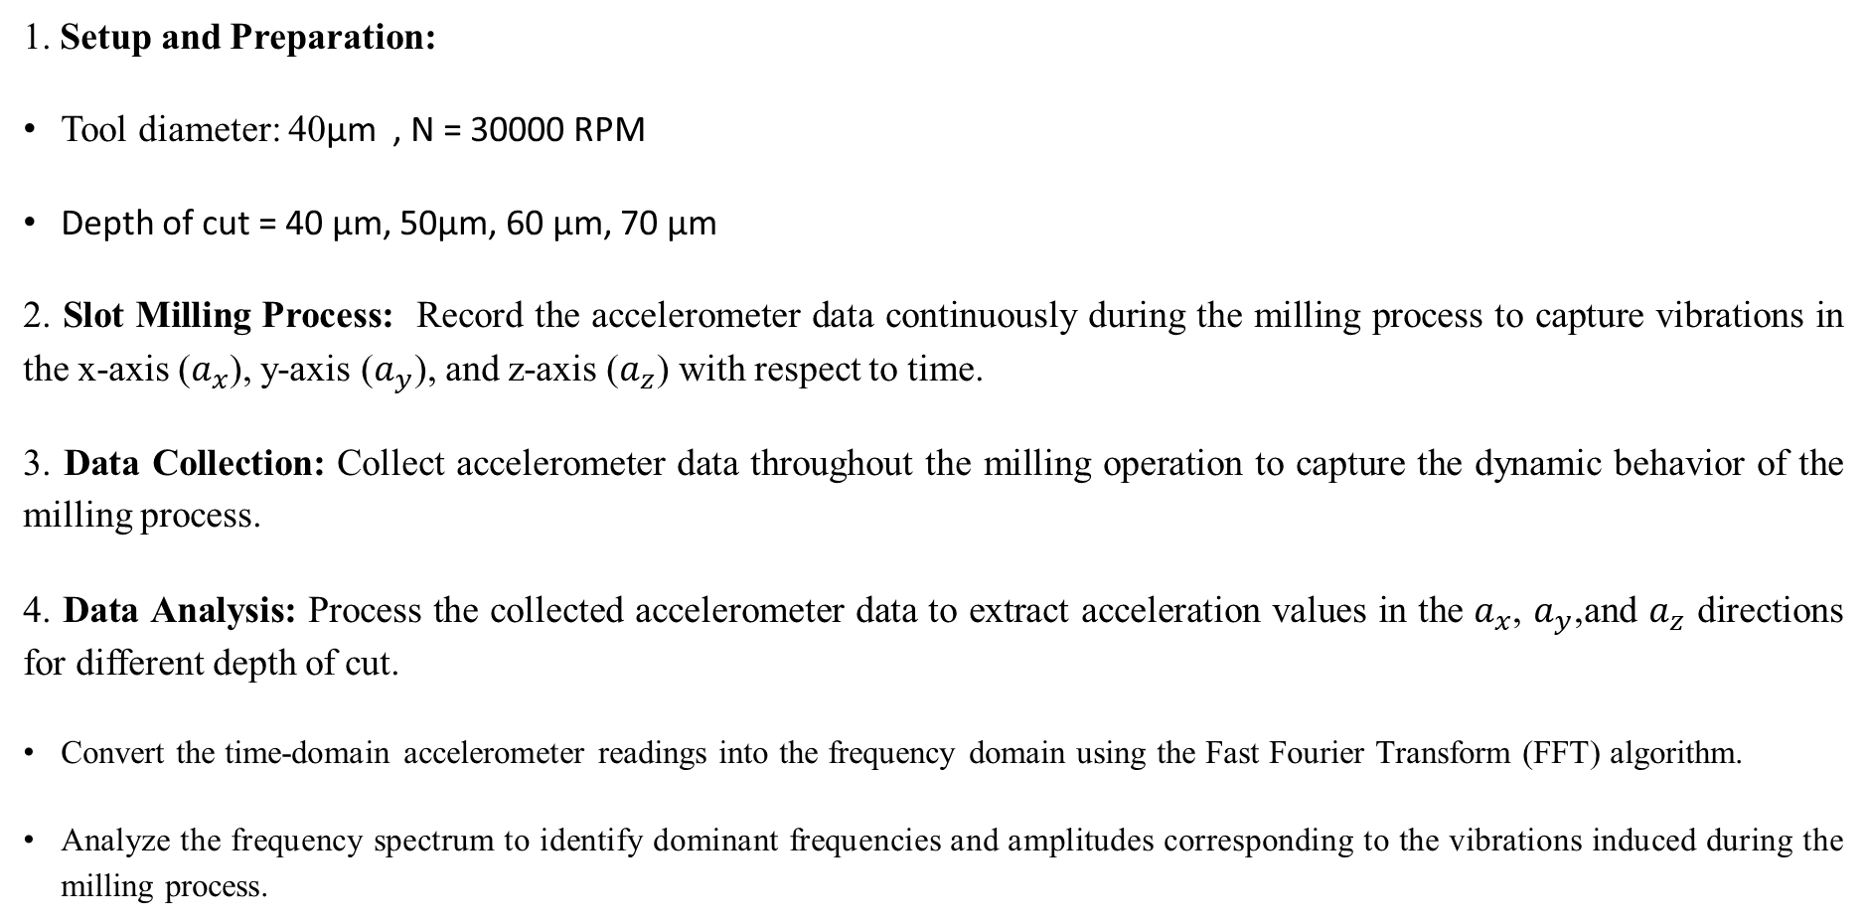
METHODOLOGY
1. Setup and Preparation:
Tool diameter: 40µm , N = 30000 RPM
Depth of cut = 40 µm, 50µm, 60 µm, 70 µm
2. Slot Milling Process: Record the accelerometer data continuously during the milling process to capture vibrations in the x-axis ($a_{x}$), y-axis ($a_{y}$), and z-axis ($a_{z}$) with respect to time.
3. Data Collection: Collect accelerometer data throughout the milling operation to capture the dynamic behavior of the milling process.
4. Data Analysis: Process the collected accelerometer data to extract acceleration values in the $a_{x}$, $a_{y}$,and $a_{z}$ directions for different depth of cut.
Convert the time-domain accelerometer readings into the frequency domain using the Fast Fourier Transform (FFT) algorithm.
Analyze the frequency spectrum to identify dominant frequencies and amplitudes corresponding to the vibrations induced during the milling process.

Slide 4
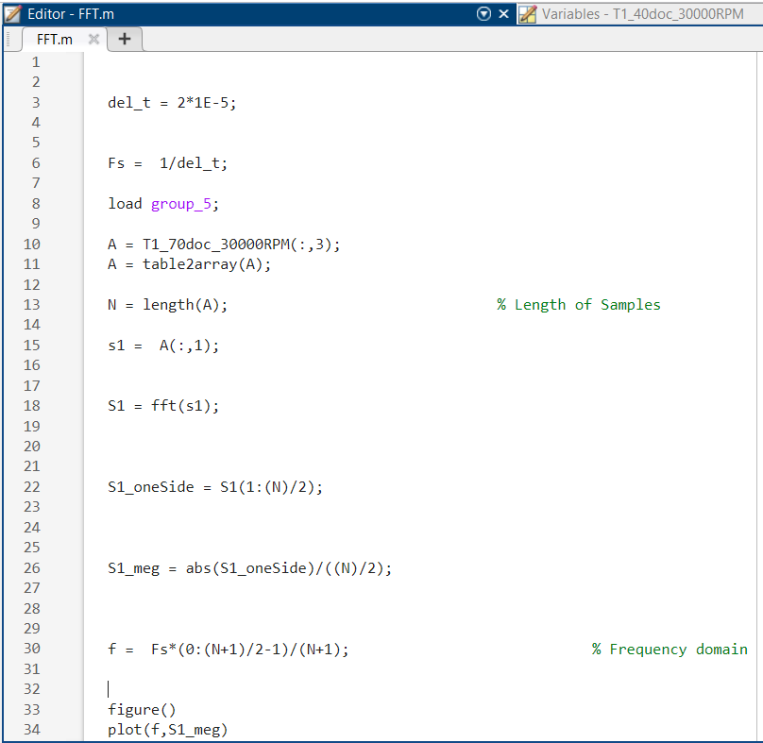

MATLAB CODE

Slide 5
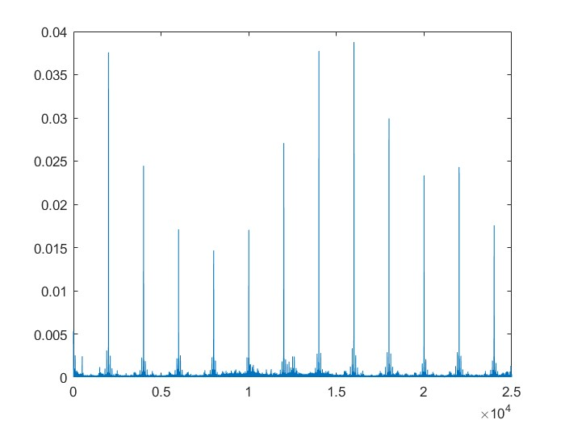
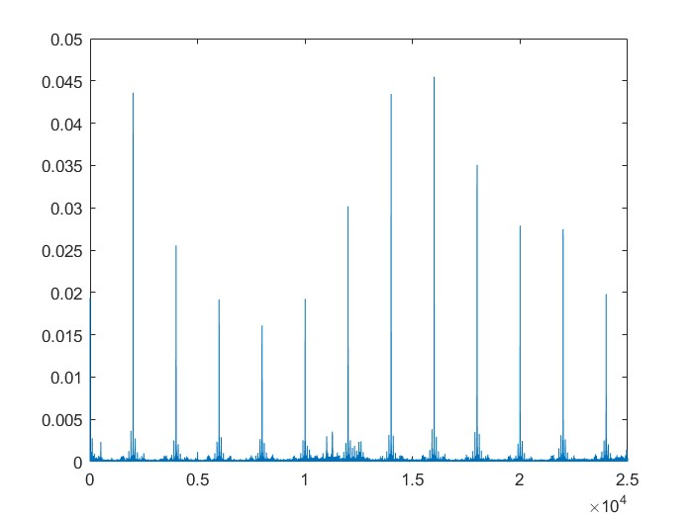
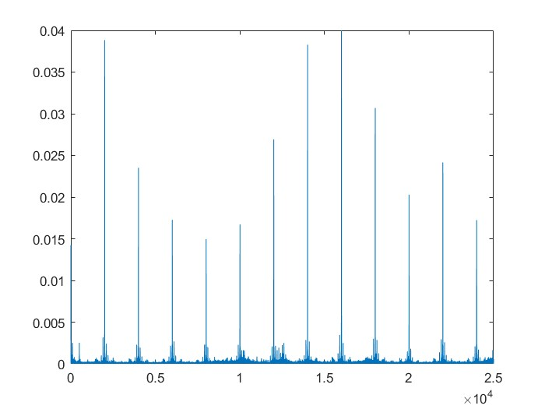
Results and Discussions
Depth of Cut = 40 µm RPM =30000
Fig 1(a) X-direction
Fig 1(b) Y-direction ​
Fig 1(c) Z-direction ​
Amplitude (mm)
Frequency (Hertz)

Slide 6
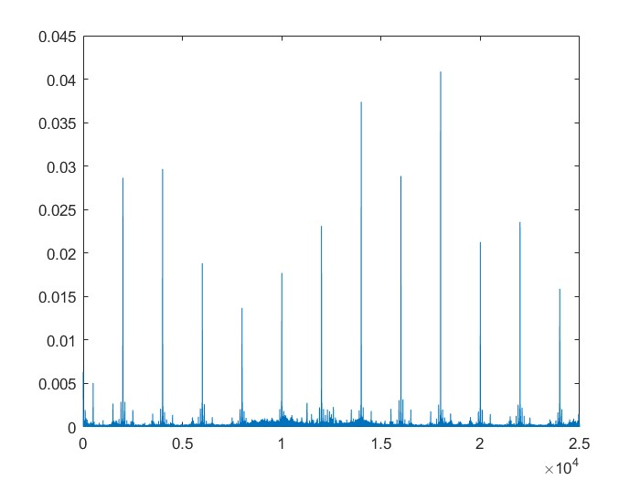
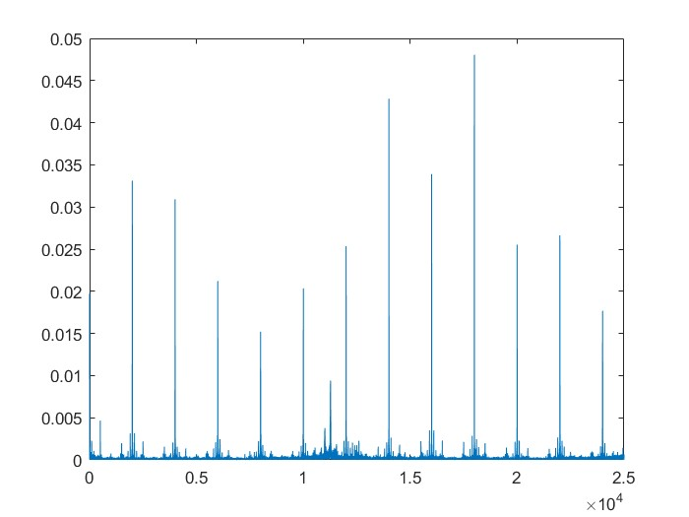
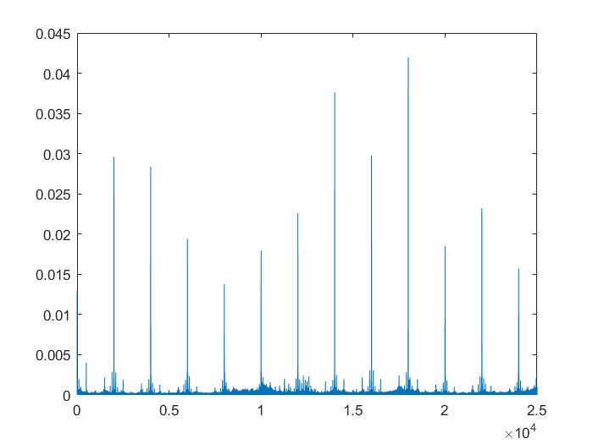
Results and Discussions
Depth of Cut = 50 µm, RPM =30000​
Fig 2(a) X-direction
Fig 2(b) Y-direction
Fig 2(c) Z-direction

Slide 7
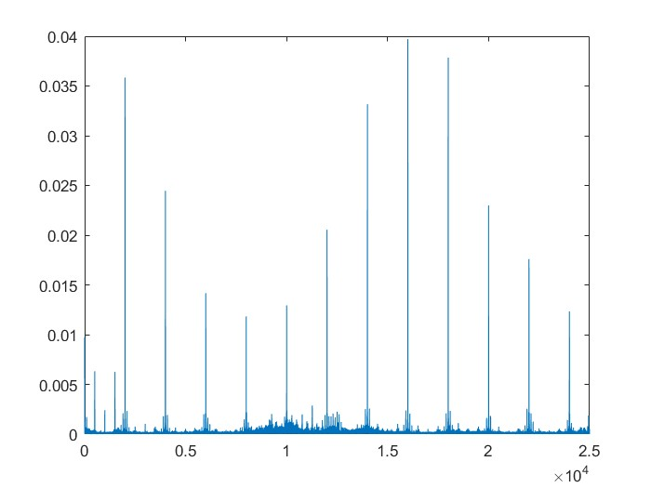
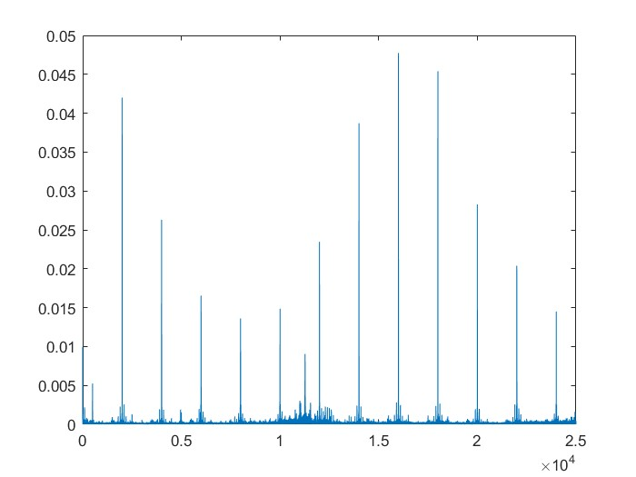
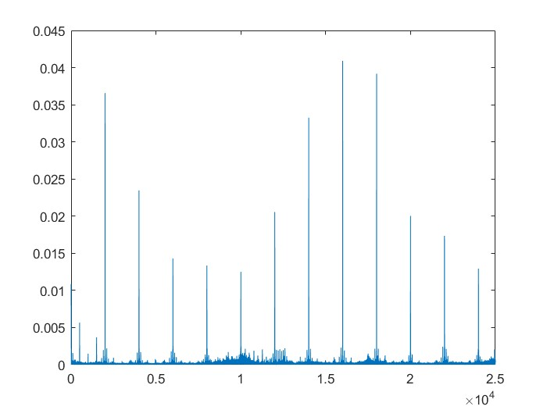
Results and Discussions
Depth of Cut = 60 µm, RPM =30000​
Fig 3(a) X-direction
Fig 3(b) Y-direction
Fig 3(c) Z-direction

Slide 8
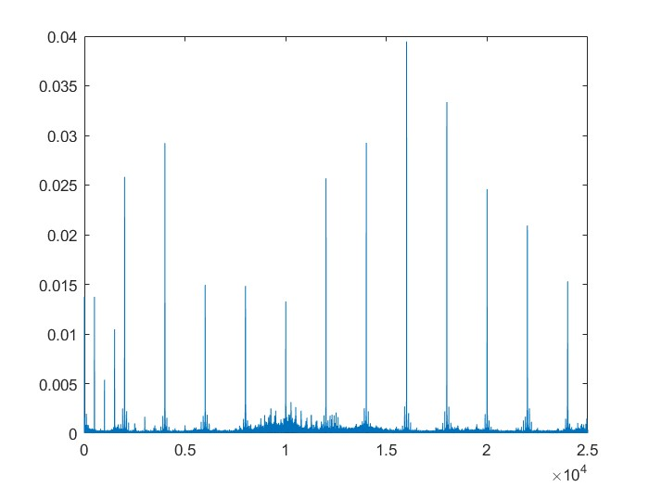
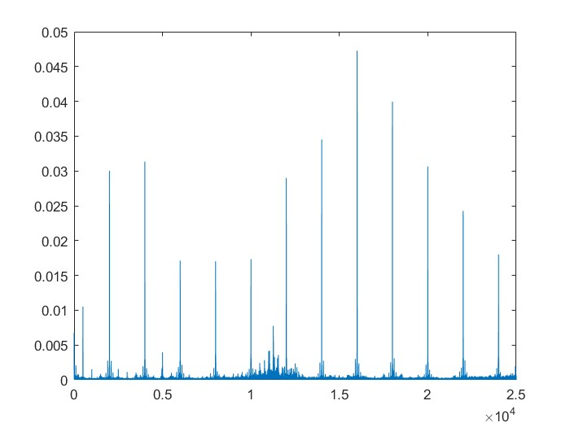
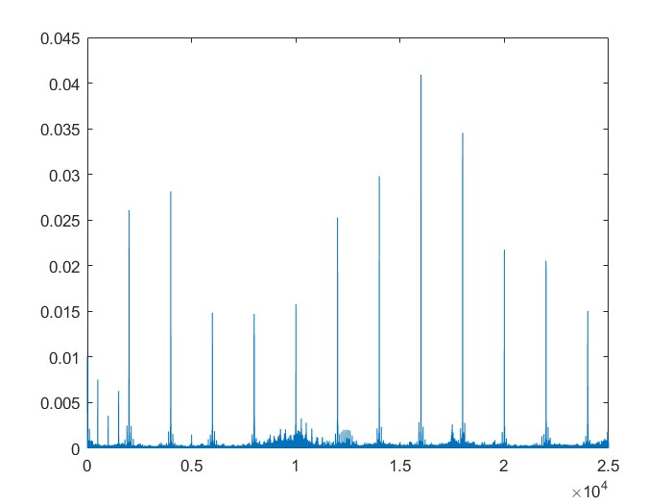
Results and Discussions
Depth of Cut = 70 µm, RPM =30000​
Fig 4(a) X-direction
Fig 4(b) Y-direction
Fig 4(c) Z-direction

Slide 9
Conclusions
The conclusion drawn from the Hands on project in the micro milling process provides valuable insights into the dynamic behavior of the machining operation.
By examining the accelerometer data, it becomes evident how various factors such as tool wear, cutting parameters, and material properties influence the vibration and acceleration patterns during milling.
Additionally, the analysis may reveal critical points where excessive vibrations occur, potentially leading to tool breakage or surface defects.
Understanding these dynamics enables optimization strategies to be developed, including adjustments to cutting parameters or tool geometries to mitigate vibrations and improve machining performance.

